Slide 1


<Elina>
<02.2026>

Slide 2

Outline
Executive Summary
Introduction
Methodology
Results
Conclusion
Appendix

Slide 3
Executive Summary
Summary of methodologies
Data loading, cleaning, and train–test split\
Feature scaling for distance-based models
Training of multiple classifiers (Logistic Regression, SVM)
Hyperparameter tuning using GridSearchCV
Model evaluation with standard classification metrics
Summary of all results
Baseline and tuned models showed similar performance
Logistic Regression provided stable results with low training time
SVM achieved comparable scores but required significantly more computation
Final model selection balanced performance and efficiency

Slide 4
Introduction
Project Background & Problem:
The commercial space industry is rapidly growing, with SpaceX leading due to low-cost reusable rockets.
Falcon 9 launches cost ~$62M, significantly less than competitors, mainly because of first-stage reusability.
The first stage is large, expensive, and not always successfully recovered.
Predicting whether the first stage will land allows better launch cost estimation.
In this project, we act as data scientists at SpaceY, using public data and machine learning to predict first-stage reuse.

Slide 5

Section 1

Slide 6
Methodology
Executive Summary
Data collection methodology:
Launch data was collected using the SpaceX REST API (/v4/launches/past) and web scraping of Falcon 9 tables from Wikipedia using BeautifulSoup.
Perform data wrangling
JSON responses were normalized into tabular format, multiple API endpoints were joined, Falcon 1 launches were removed, and missing values were handled.
Perform exploratory data analysis (EDA) using visualization and SQL
Perform interactive visual analytics using Folium and Plotly Dash
Perform predictive analysis using classification models
Predictive Analysis: Classification models were trained to predict first-stage landing outcomes.Modeling: Models were built, tuned with GridSearchCV, and evaluated using standard classification metrics.

Slide 7
Data Collection
The datasets were collected from publicly available sources. Historical SpaceX launch data was retrieved using the SpaceX REST API through multiple endpoints. Additional Falcon 9 launch records were obtained by web scraping Wikipedia tables. The collected data was cleaned, normalized, and merged into a single structured dataset for analysis.

Slide 8
Data Collection – SpaceX API
Present your data collection with SpaceX REST calls using key phrases and flowcharts
https://github.com/ElinaGorniker/DS_Capstone/blob/main/jupyter-labs-spacex-data-collection-api.ipynb
SpaceX REST API
HTTP GET Requests
JSON Responses
Data Normalization
Pandas DataFrame
Data Cleaning & Filtering (Falcon 9 only)
Final Dataset

Slide 9
Data Collection - Scraping
Present your web scraping process using key phrases and flowcharts
https://github.com/ElinaGorniker/DS_Capstone/blob/main/jupyter-labs-webscraping.ipynb
Wikipedia Pages
HTML Tables
BeautifulSoup
Pandas DataFrame
Merge with API Data

Slide 10
Data Wrangling
Raw SpaceX launch data was cleaned and transformed into a structured dataset suitable for machine learning. Relevant features related to launch conditions and landing outcomes were selected, cleaned, encoded, and converted into numerical formats. The landing outcome was transformed into a binary target variable for classification.
https://github.com/ElinaGorniker/DS_Capstone/blob/main/labs-jupyter-spacex-Data%20wrangling.ipynbv
Raw API & Web Data
Feature Selection
Flight No
Date
Data Cleaning
Remove Falcon 1
Payload Mass
Orbit
Launch Site
Landing Outcome etc.
handle NULL values
Target Variable Creation
Landing Outcome → y: 0 = Fail, 1 = Success
Categorical Encoding
Orbit
Launch Site
Landing Type
Final Clean Dataset
Ready for EDA & Modeling

Slide 11
EDA with Data Visualization
Summarize what charts were plotted and why you used those charts
Charts Used and Purpose
Time Series Plots — to observe trends in landing success over time and identify improvements in success rates since 2013.
Bar Charts — to compare landing success rates across different launch sites and orbits.
Scatter Plots (Payload Mass vs. Outcome) — to analyze the relationship between payload mass and landing success.
Colored Scatter Plots — to examine combined effects of multiple features (e.g., launch site and payload mass) on landing outcomes.
Categorical Distribution Plots — to assess the impact of categorical variables such as orbit type and launch site.
These visualizations helped identify key features associated with successful first-stage landings and guided feature selection for machine learning models.
https://github.com/ElinaGorniker/DS_Capstone/blob/main/https://github.com/ElinaGorniker/DS_Capstone/blob/main/edadataviz.ipynb

Slide 12
EDA with SQL
SQL Queries Summary (EDA)
Connected to a SQLite database containing SpaceX launch data.
Created a cleaned working table by filtering out records with missing launch dates.
Retrieved a list of distinct launch sites to understand launch location diversity.
Filtered launches from specific sites (e.g., CCAFS) to inspect subsets of data.
Calculated the total payload mass delivered for NASA CRS missions.
Computed the average payload mass for a specific Falcon 9 booster version.
Identified the earliest successful mission date.
Retrieved all distinct landing outcomes to understand possible result categories.
Selected booster versions associated with successful drone ship landings within a specific payload mass range.
Counted total launch records with defined success or failure outcomes.
Identified the booster version with the maximum payload mass.
Extracted failed drone ship landings for a specific year to analyze failure patterns.
Aggregated and ranked landing outcomes over time using grouping and ordering.
https://github.com/ElinaGorniker/DS_Capstone/blob/main/jupyter-labs-eda-sql-coursera_sqllite.ipynb

Slide 13
Build an Interactive Map with Folium
Map Objects Created
Markers were added to display SpaceX launch site locations.
Circle markers were used to highlight launch sites and visually emphasize their geographic positions.
Lines (Polylines) were drawn between launch sites and the closest infrastructure points (cities, railways, highways).
Popups were attached to markers to display contextual information such as site names and distances.
Purpose of Map Objects
Markers and circles help visualize the exact geographic locations of launch sites.
Lines illustrate the distance between launch sites and nearby infrastructure, providing spatial context.
Popups enhance interactivity and allow users to explore distance and location details.
Overall, these objects support spatial analysis and help identify geographical factors that may influence launch and landing operations.
https://github.com/ElinaGorniker/DS_Capstone/blob/main/lab_jupyter_launch_site_location.ipynb

Slide 14
Build a Dashboard with Plotly Dash
Plotly Dash Dashboard Summary
Pie Chart: Displays launch success distribution for all sites or success vs. failure for a selected site.
Scatter Plot: Shows the relationship between payload mass and launch success.
Dropdown: Allows selection of all launch sites or a specific site.
Range Slider: Filters launches by payload mass range.
Purpose: Enable interactive exploration of factors affecting launch success.
https://github.com/ElinaGorniker/DS_Capstone/blob/main/spacex-dash-app.py

Slide 15
Predictive Analysis (Classification)
Model Development Summary
Built baseline classification models and evaluated them using train–test split.
Improved performance through feature scaling and hyperparameter tuning with cross-validation.
Selected the best model based on evaluation metrics and overall stability.
https://github.com/ElinaGorniker/DS_Capstone/blob/main/SpaceX_Machine%20Learning%20Prediction_Part_5%20(1).ipynb
Clean Dataset
Train / Test Split
Baseline Models
Hyperparameter Tuning
Cross-Validation
Model Evaluation
Best Performing Model

Slide 16
Results
Exploratory Data Analysis (EDA)
Landing success rate increased over time.
Launch site and payload mass showed strong correlation with landing success.
Combined features provided better insight than single variables.
Interactive Analytics (Dashboard & Maps)
Interactive dashboards enabled dynamic exploration by launch site and payload range.
Maps visualized launch locations and proximity to infrastructure.
User interactions helped identify patterns affecting launch outcomes.
Predictive Analysis
Multiple classification models were trained and evaluated.
Hyperparameter tuning improved model performance.
The best model was selected based on accuracy and stability.

Slide 17

Section 2

Slide 18
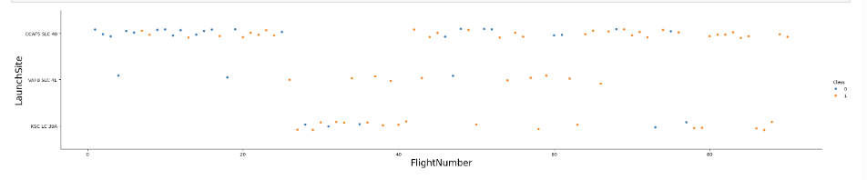
Flight Number vs. Launch Site
The launch success rate increases as the flight number grows, indicating performance improvement over time.
Different launch sites show different success patterns.
Later missions are more likely to result in successful first-stage landings.
Conclusion: Flight number and launch site are important features for predicting landing success.

Slide 19
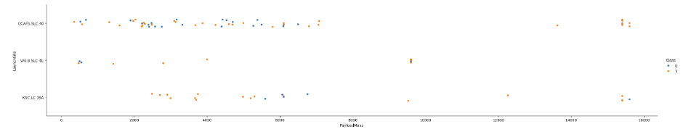
Payload vs. Launch Site
EDA Insight – Payload Mass vs. Launch Site
The VAFB-SLC-4E launch site does not handle heavy payload missions.
No launches from VAFB-SLC-4E have payload masses greater than 10,000 kg.
Heavy payload missions are launched only from CCAFS and KSC sites.
Conclusion: Payload mass capability varies by launch site, making launch site an important feature for predicting mission outcomes.

Slide 20
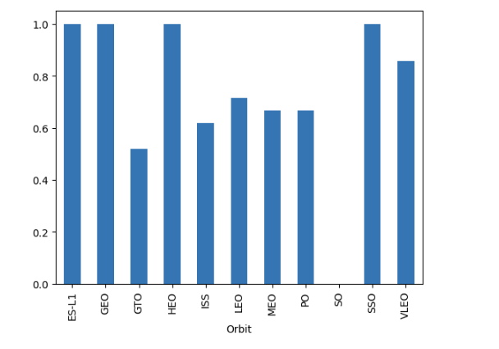
Success Rate vs. Orbit Type
EDA Insight – Orbit
Landing success rates vary significantly across different orbit types.
Orbits such as GEO, HEO, ES-L1, and SSO show very high success rates.
GTO missions have a noticeably lower success rate compared to other orbits.
Medium Earth orbits (LEO, MEO, PO) demonstrate moderate and consistent success.
Conclusion: Orbit type influences landing success and is an important feature for predictive modelin

Slide 21
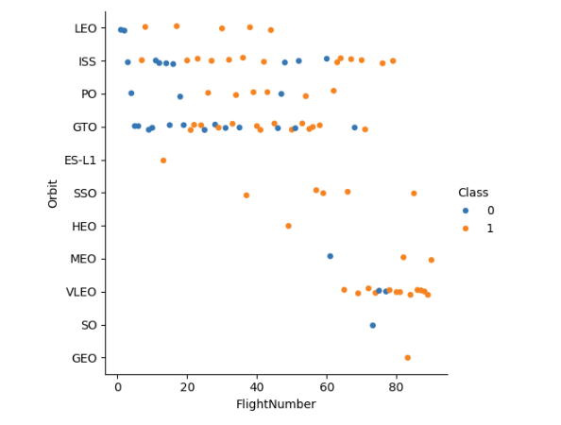
Flight Number vs. Orbit Type
EDA Insight – Orbit vs. Flight Number
Landing success improves over time across most orbit types.
Early missions show more failures, while later missions are predominantly successful.
Orbits such as LEO, ISS, and VLEO demonstrate higher success rates in later flights.
GTO missions exhibit mixed outcomes, indicating higher mission complexity.
Conclusion: Both orbit type and mission timeline (flight number) influence first-stage landing success and are valuable predictive features.

Slide 22
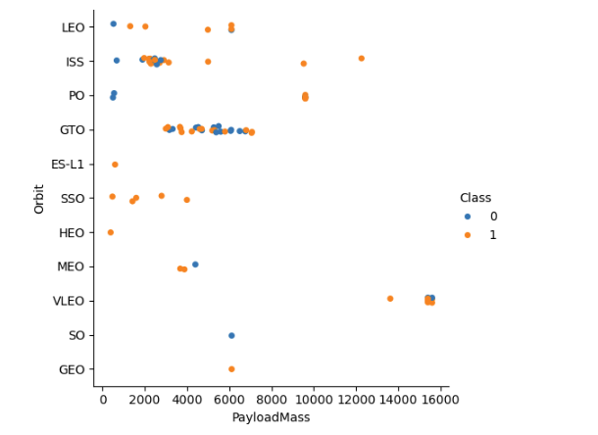
Payload vs. Orbit Type
Landing success varies across different orbit types and payload masses.
Higher payload masses are mainly associated with VLEO and GEO missions, which show a high success rate.
GTO missions cluster at medium payload masses and exhibit mixed success outcomes.
Lower payload orbits (e.g., LEO, ISS) show both successes and failures but trend toward success.
Conclusion: Both orbit type and payload mass influence landing success and are important features for predictive modeling.

Slide 23
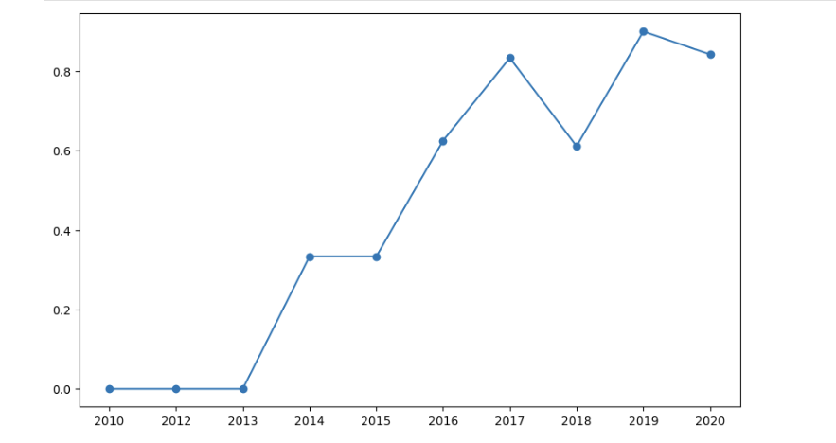
Launch Success Yearly Trend
Landing success rate increases significantly over the years.
Early missions (2010–2013) show almost no successful landings.
From 2016 onward, success rates exceed 60% and peak around 90%.
Conclusion: Technological improvements over time strongly increased first-stage landing success, making year/flight number a key predictive feature.

Slide 24
All Launch Site Names
CCAFS LC-40
VAFB SLC-4E
KSC LC-39A
CCAFS SLC-40
Unique Launch Sites
Query Result: The dataset contains three unique launch sites:
Explanation: These are the distinct SpaceX launch locations identified in the data. Each site supports different mission profiles and shows different landing success patterns, which makes launch site an important feature for analysis and prediction.

Slide 25
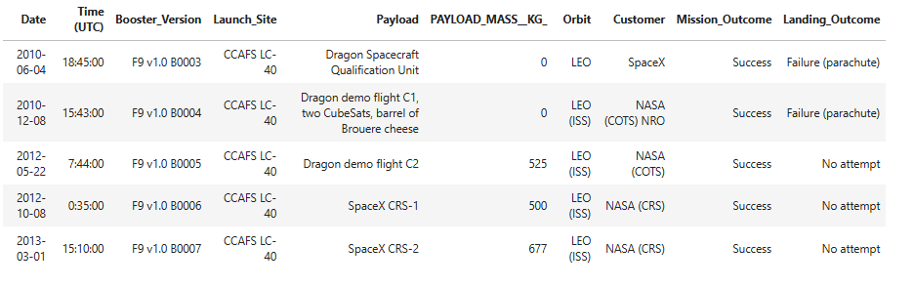
Launch Site Names Begin with 'CCA'
This query filters launch records by launch site name using a prefix condition (CCA%). The result confirms that multiple launches were conducted from Cape Canaveral Air Force Station, which is one of SpaceX’s primary and most frequently used launch sites.

Slide 26
Total Payload Mass
Total Payload Mass for NASA Missions
Query Result: The total payload mass carried by boosters for NASA missions is 45,596 kg.
Explanation: This result was obtained by summing the payload masses of all launches where the customer was NASA. It represents the cumulative payload delivered by SpaceX boosters for NASA-related missions.

Slide 27
Average Payload Mass by F9 v1.1
Query Result: The average payload mass carried by boosters for NASA missions is 2,534.67 kg.
Explanation: This value was calculated by averaging the payload masses of all launches associated with NASA. It shows the typical payload size delivered per NASA mission by SpaceX boosters.

Slide 28
First Successful Ground Landing Date
Query Result: The first successful landing outcome on a ground pad occurred on 2010-06-04.
Explanation: This date represents the earliest recorded mission in the dataset where the first stage successfully landed on a ground pad, marking an important milestone in SpaceX’s landing operations.

Slide 29
Successful Drone Ship Landing with Payload between 4000 and 6000
Query Result: The following boosters successfully landed on a drone ship and carried a payload mass greater than 4,000 kg but less than 6,000 kg:
F9 FT B1022
F9 FT B1026
F9 FT B1021.2
F9 FT B1031.2
Explanation: These boosters were identified by filtering launch records for successful drone ship landings and selecting missions with payload masses within the specified range. This result highlights Falcon 9 Full Thrust boosters that successfully supported mid-range payload missions with drone ship recovery.

Slide 30
Total Number of Successful and Failure Mission Outcomes
Query Result: The total number of missions with a recorded successful or failed outcome is 71.
Explanation: This value represents all launch records in the dataset where the mission outcome is clearly defined as either a success or a failure. These records were used for further analysis and predictive modeling.

Slide 31
Boosters Carried Maximum Payload
Query Result: The following boosters carried the maximum payload mass recorded in the dataset:
F9 B5 B1048.4
F9 B5 B1049.4
F9 B5 B1051.3
F9 B5 B1056.4
F9 B5 B1048.5
F9 B5 B1051.4
F9 B5 B1049.5
F9 B5 B1060.2
F9 B5 B1058.3
F9 B5 B1051.6
F9 B5 B1060.3
F9 B5 B1049.7
Explanation: These boosters correspond to launch records where the payload mass reached the maximum value observed in the dataset. Identifying these boosters helps highlight the Falcon 9 Block 5 vehicles that supported the heaviest payload missions.

Slide 32
2015 Launch Records
Query Result: The following records show drone ship landing failures in 2015, including the month, booster version, and launch site:
January — Failure (drone ship), F9 v1.1 B1012, CCAFS LC-40
April — Failure (drone ship), F9 v1.1 B1015, CCAFS LC-40
Explanation: These records were obtained by filtering launches from the year 2015 with landing outcomes marked as drone ship failures. The month number was converted to the corresponding month name for readability.

Slide 33
Rank Landing Outcomes Between 2010-06-04 and 2017-03-20
Query Result (Descending Order):
No attempt — 10
Success (drone ship) — 5
Failure (drone ship) — 5
Success (ground pad) — 3
Controlled (ocean) — 3
Uncontrolled (ocean) — 2
Failure (parachute) — 2
Precluded (drone ship) — 1
Explanation: The results rank landing outcomes within the specified date range by frequency. “No attempt” is the most common outcome in early missions, while successful drone ship landings begin to appear and increase, reflecting SpaceX’s gradual transition toward reusable first-stage recovery during this period.

Slide 34

Section 3

Slide 35
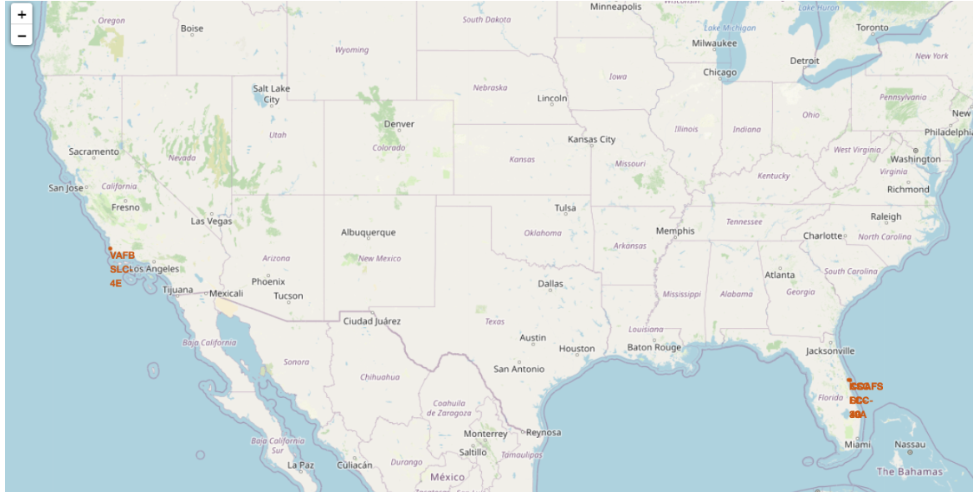
Global Locations of SpaceX Launch Sites
The Folium map displays the geographic locations of SpaceX launch sites on a global map. Each marker represents a launch site, allowing interactive exploration through zooming and panning.
Key elements shown on the map:
Location markers for all SpaceX launch sites (e.g., CCAFS LC-40, KSC LC-39A, VAFB SLC-4E).
Global basemap providing geographic context (continents, coastlines, and cities).
Interactive controls (zoom in/out) to explore launch site proximity and spatial distribution.
Important Findings
SpaceX launch sites are strategically distributed across different geographic regions.
Launch sites are positioned to support different orbital inclinations and mission requirements.

Slide 36
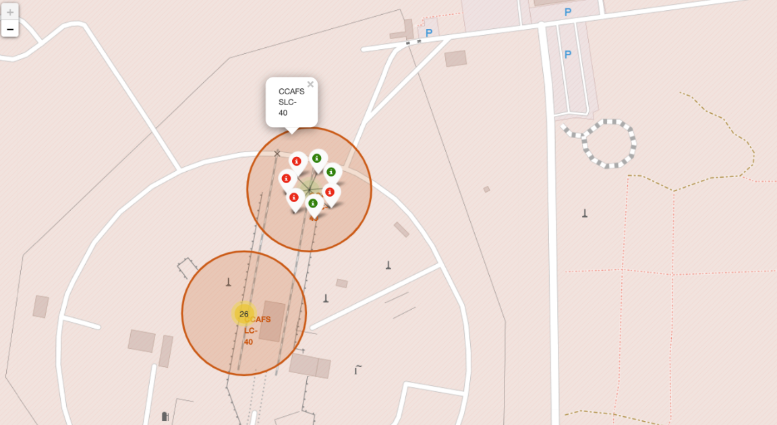
Marker Cluster for Launch Records
What was done
Created markers for all launch records.
Used green markers for successful launches (class = 1).
Used red markers for failed launches (class = 0).
Added a MarkerCluster to group markers that share the same coordinates.
Why MarkerCluster is needed
Multiple launches occur at the same launch site, so many records have identical coordinates.
Marker clustering prevents marker overlap and keeps the map readable.
Clusters expand automatically when zooming in, allowing detailed inspection

Slide 37
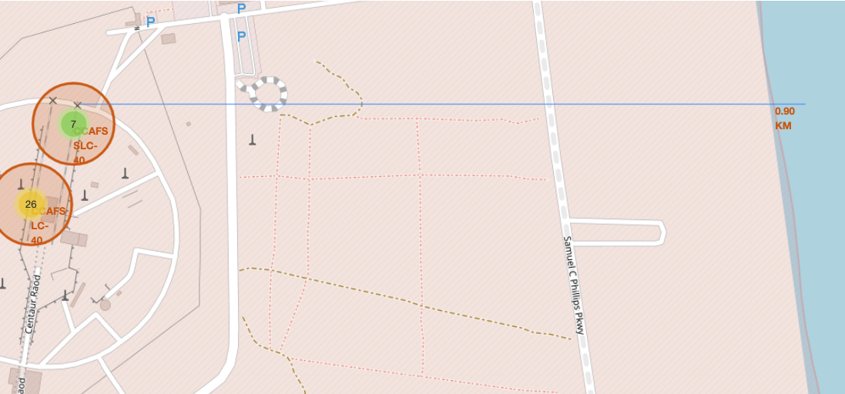
Selected Launch Site Proximity
The selected launch site (CCAFS SLC-40) is shown with nearby infrastructure on the Folium map.
Distances to surrounding features such as the coastline, roads, and facilities are calculated and displayed.
The site is located within close proximity to the coast, which supports safe launch operations.

Slide 38

Section 4

Slide 39
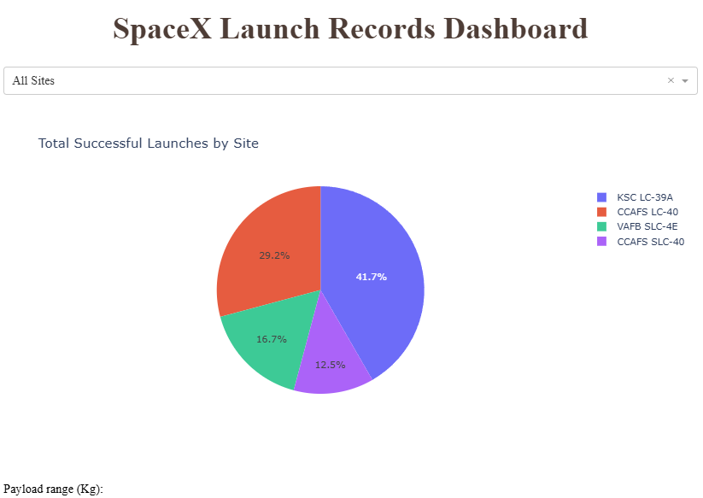
Dashboard Insight: Launch Success by Site
Important Elements
Dropdown menu allows selecting all launch sites or a specific site.
Pie chart shows the distribution of successful launches by launch site.
Legend and percentages clearly compare site contributions.
Key Findings
KSC LC-39A has the highest share of successful launches.
CCAFS LC-40 also contributes a significant portion of successes.
VAFB SLC-4E and CCAFS SLC-40 show lower but meaningful success shares.
Conclusion: Launch success is not evenly distributed across sites, making launch site an important factor in performance analysis.

Slide 40
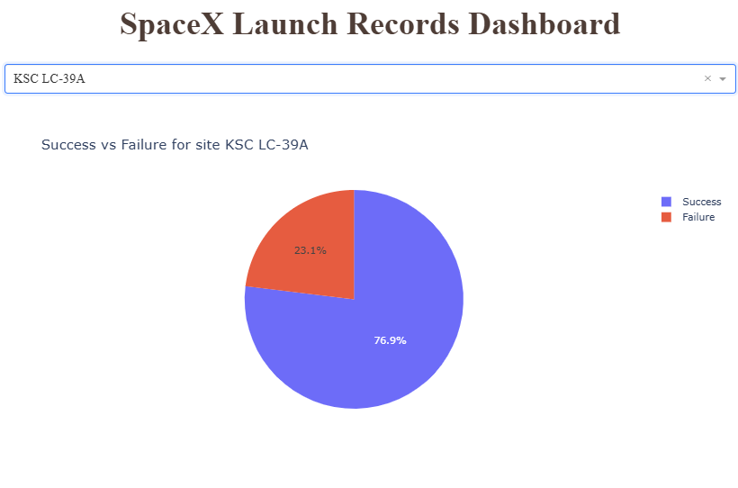
Dashboard Insight: Success vs Failure at KSC LC-39A
Important Elements
Dropdown selection is set to KSC LC-39A, filtering data for a single launch site.
Pie chart shows the proportion of successful vs failed launches at this site.
Percent labels clearly indicate performance distribution.
Key Findings
KSC LC-39A demonstrates a high success rate (~77%).
Failures represent a smaller portion (~23%) of launches at this site.
Conclusion: KSC LC-39A is one of the most reliable launch sites, showing consistently strong launch performance.

Slide 41
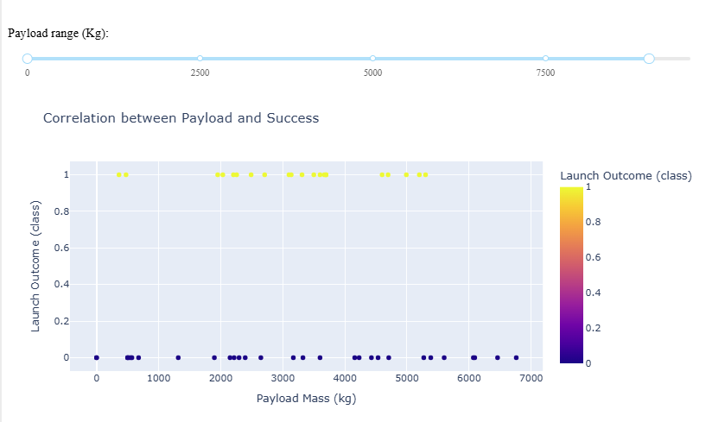
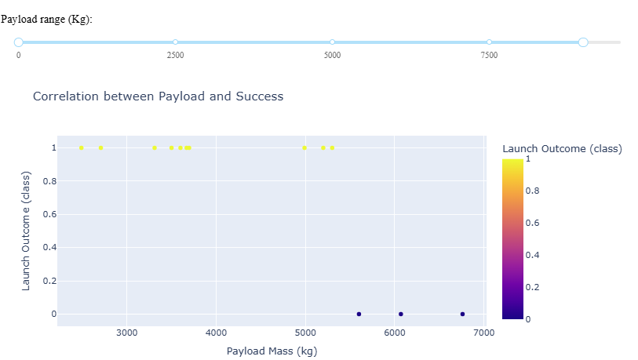
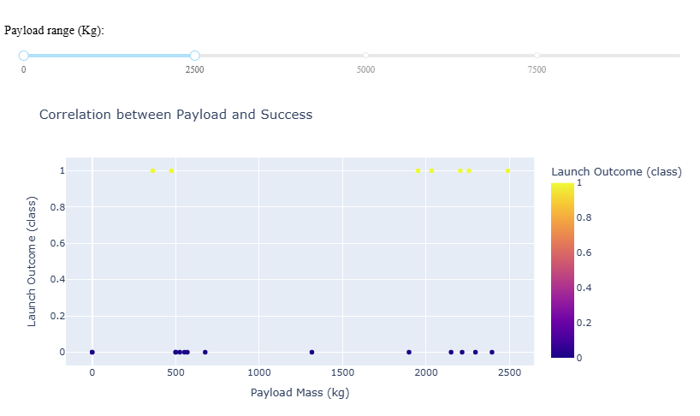
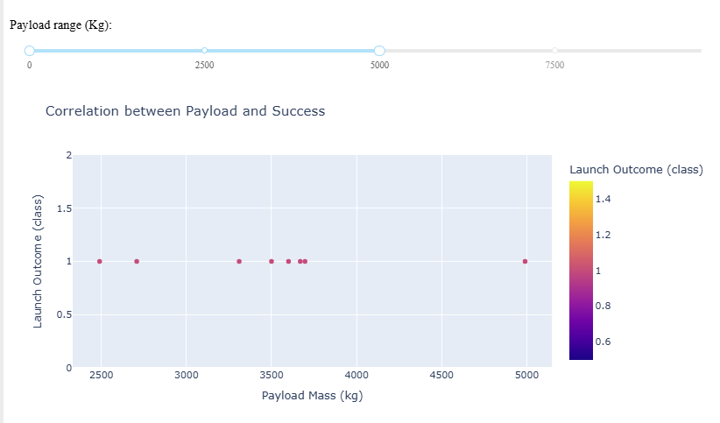
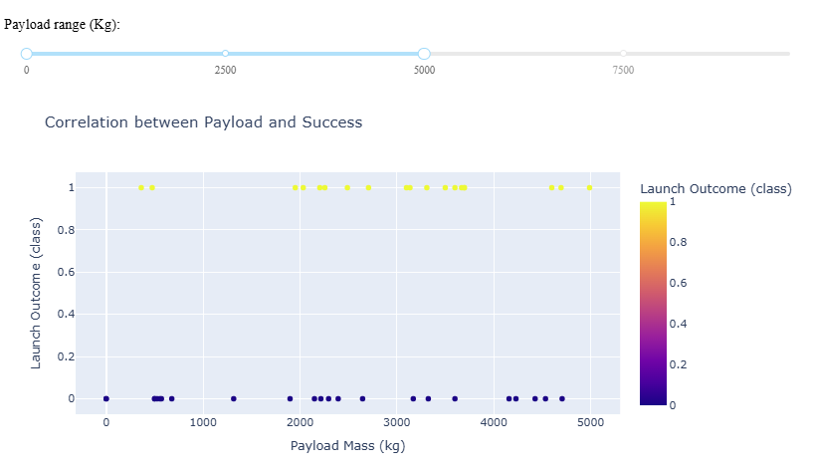
Dashboard Insight: Payload Mass vs Launch Outcome
Important Elements
Range Slider (Payload Mass) allows filtering launches by payload range.
Scatter Plot shows the relationship between Payload Mass (kg) and Launch Outcome (class).
Color scale indicates launch outcome:
1 — Successful landing
0 — Failed landing
Key Findings
Low payload ranges show a mix of successes and failures.
Medium payload ranges (≈ 2,500–5,000 kg) demonstrate a higher concentration of successful launches.
Very high payload ranges contain fewer data points and show more variability in outcomes.
Overall, payload mass influences launch success, but it is not the only determining factor.
Conclusion
Payload mass is an important feature for predicting launch success, especially when combined with other variables such as launch site and booster version.

Slide 42

Section 5

Slide 43
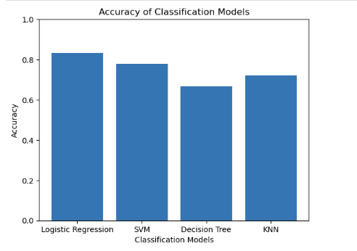
Classification Accuracy
Model Accuracy Comparison
The bar chart compares the classification accuracy of four models: Logistic Regression, SVM, Decision Tree, and KNN. Logistic Regression achieves the highest accuracy, followed by SVM. Decision Tree shows the lowest performance, while KNN provides moderate accuracy.
Conclusion: Logistic Regression is the best-performing model based on accuracy and was selected as the final model.

Slide 44
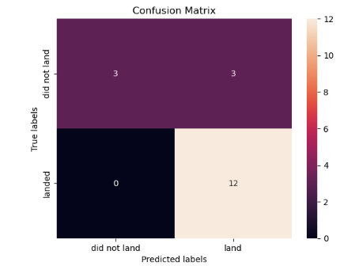
Confusion Matrix
Key Insight
The model is very strong at identifying successful landings (no missed successes).
Some failures are misclassified as successes, indicating a slight bias toward predicting successful landings.

Slide 45
Conclusions
SpaceX launch data was collected, cleaned, and prepared using APIs, SQL, and data wrangling techniques.
Exploratory analysis revealed that launch site, payload mass, orbit type, and time strongly impact landing success.
Interactive maps and dashboards enabled clear visualization of geographic and operational patterns.
Multiple classification models were trained and evaluated using accuracy and confusion matrices.
Logistic Regression achieved the best performance, providing reliable predictions of first-stage landing success.

Slide 46
Appendix
Include any relevant assets like Python code snippets, SQL queries, charts, Notebook outputs, or data sets that you may have created during this project

Slide 47


